Slide 1

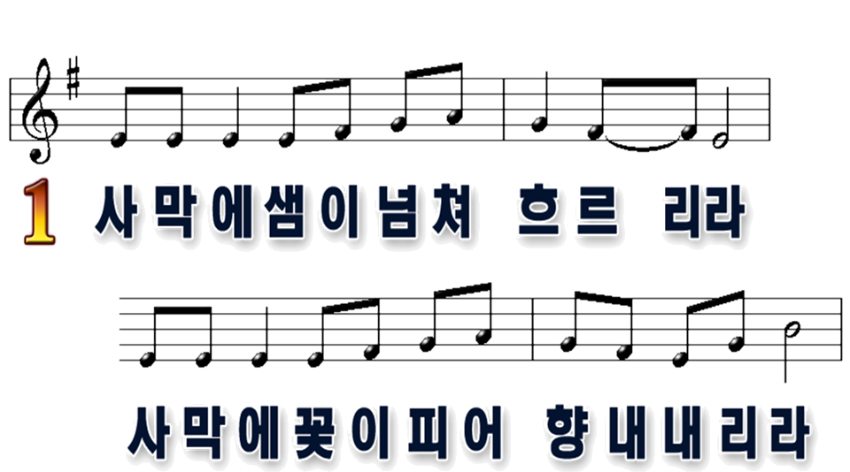

1
2

Slide 2

1
2

Slide 3
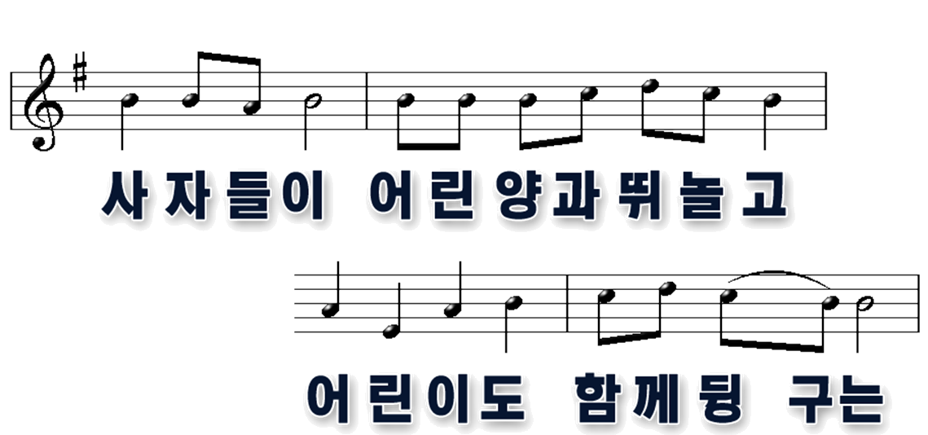
1
2

Slide 4

1
2

Slide 5
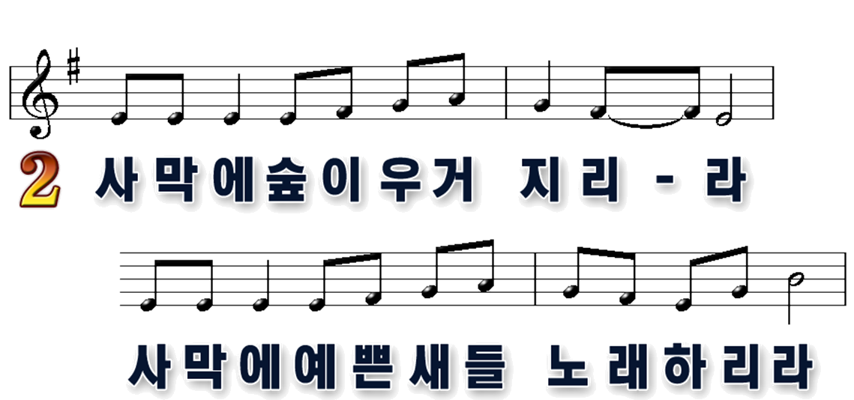
1
2

Slide 6
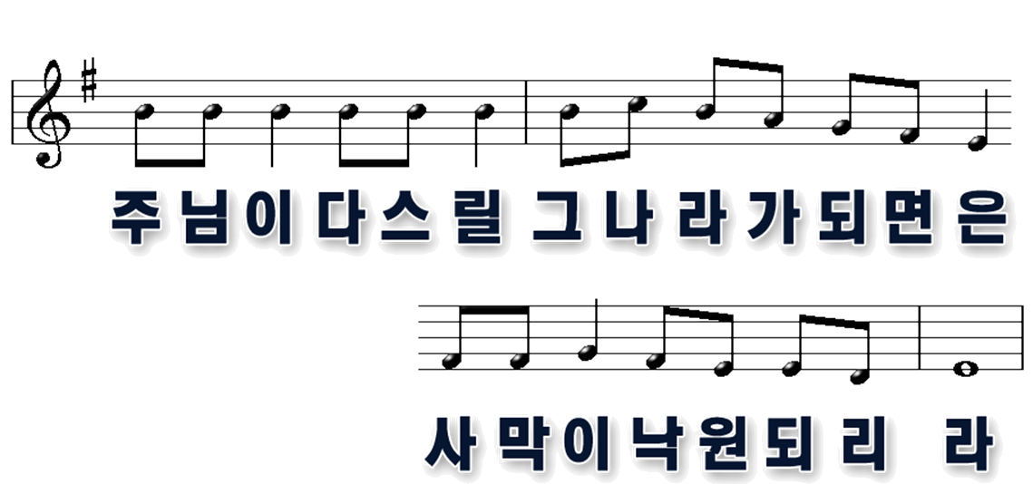
1
2

Slide 7
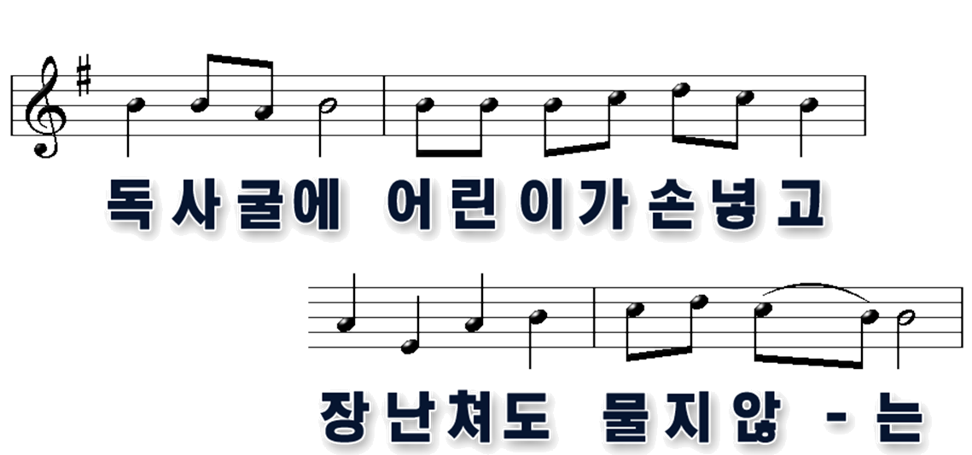
1
2

Slide 8
1
2

